Slide 1
Book Recommendation System
Based on content

Slide 2
Content-based recommendation system

Slide 3
Intro
A content-based recommendation system recommends items to a user by taking similarity of items. This recommender system recommends products or items based on the description or features. It identifies the similarity between the products based on their description. It also considers the user's previous history in order to recommend a similar product.
Example: If a user likes the novel “Tell me your dreams” by Sidney Sheldon, then the recommender system recommends the user to read other Sidney Sheldon’s novels or it recommends a novel with the genre “Non-fiction”. (Sidney Sheldon novels belong to Non-fiction genre).

Slide 4
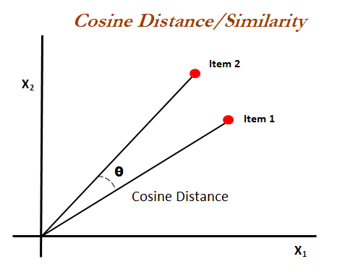
How to find Similarity?
We need to find similar books to a given book and then recommend those similar books to the user. How to find whether the given book is similar or dissimilar? A similarity measure was used to find the same.
There are different similarity measures are available. Cosine Similarity was used in our recommender system to recommend the books.

Slide 5
Recommendation engine
We are going to build recommendation engine using the book title.
Convert each book title and description into vectors using TF-IDF and bigram.
We are building recommendation engine, with a book title. The model recommends a similar book based on title and description.
Calculate the similarity between all the books using cosine similarity.
Define a function that takes book title and genre as an input and returns the top five similar recommended books based on the title and description.

Slide 6

Thanks!
Contact us:
Rakshit
Mob - 9728399933
rrakshit60_be20@thapar.edu

